Slide 1
Fundamentals of database
Unit 9
Prepared by: Natabar Khatri New Summit College

Slide 2
Introduction
Data
Raw fact which is composed of alphabets, digits and other symbols
It may or may not give sense.
Example: 1, ram, 2.3, 60 etc.
Information
Meaningful result after processing the data
Output of processed data
Example: 2 doesn’t give meaning but Rs. 2 gives meaning

Slide 3
Database and file processing
Database
Database is an organized collection of interrelated data of objects or entities stored in tabular form. Example: phone diary, result sheet, customer records, price list etc.
Flat File System/File Processing
Traditional way of storing data electronically.
Data in flat file system are often stored in plain text format (e.g., CSV, JSON, XML)
Flat files do not support relationships or complex structures like databases.

Slide 4
Drawbacks of flat file systEm
Data redundancy and inconsistency: Flat file systems often store duplicate data, leading to inefficiency and potential inconsistencies.
Difficulty in accessing data: Retrieving specific data requires manual parsing, making it time-consuming and inefficient.
Data isolation is not inherently supported: Data is stored in a single file, making it hard to separate or isolate specific datasets.
Data security is one of the major problems: Flat files lack built-in security features like access control or encryption.
Difficult for processing complex queries: Flat files do not support advanced querying, requiring manual processing for complex requests.
Integrity and validation problems: Flat files lack mechanisms to enforce data integrity rules or validation checks.
Notes:
Data isolation refers to segregating datasets to restrict unauthorized access, enhancing security and preventing data breaches or leaks, while also ensuring data integrity within database systems.

Slide 5
Drawbacks of flatfile systm
Atomicity of updates
Failures may leave database in an inconsistent state with partial updates carried out
Example: Transfer of funds from one account to another should either complete or not happen at all
Concurrent access by multiple users
Concurrent access needed for performance
Uncontrolled concurrent accesses can lead to inconsistencies
Example: Two people reading a balance (say 100) and updating it by withdrawing money (say 50 each) at the same time
Security problems

Slide 6
Advantages of Database Approach
Redundancy can be reduced
Inconsistency can be avoided
Data can be shared
Transaction support can be provided
Integrity can be maintained
Security can be enforced
Efficient Backup and Recovery can be provided
Data in the database can be accessed easily

Slide 7
Characteristics of Database Approach
Shared
They are shared among different users and applications
Persistence
They exists permanently in the sense that the data can live beyond the scope of the process that created it.
Validity/Integrity/Correctness
Data should be correct with respect to the real world entity that they represent.
Security
Data should be protected from unauthorized access.

Slide 8
Characteristics of Database Approach
Consistency
Whenever more than one data element in a database represents related real-world values, the values should be consistent with respect to the relationship.
Non-Redundancy
No two data items in a database should represent the same real-world entity.
Independence
The three levels in the schema should be independent of each other so that the changes in the schema at one level should not affect the other levels.

Slide 9
Data models, schema and instances
Data Model:
Think of it as the blueprint that defines the overall structure and organization of data in a database.
It specifies how data entities (like people, products, or events) and their relationships are represented.
A data model consists of components for describing the data, the relationships among them, and the semantics of data and the constraints that hold data.

Slide 10
Data models, schema and instances
Many data models exist based on the way they describe the structure of database.
The data models are generally divided into three categories as follows:
High level or conceptual Data Model
Representation or implementation Data Model, and
Low level or physical Data model

Slide 11
Data models, schema and instances
Schema:
This is the detailed description of a specific database based on the chosen data model.
It acts like a blueprint for a particular house built from the general blueprint (data model).
The schema defines the structure of tables, columns within those tables (data elements), data types allowed in each column (e.g., text, number, date), and constraints that govern the data (e.g., mandatory fields, unique values).

Slide 12
Data models, schema and instances
Instance:
Instances are the actual data contained in the database at a particular point of time.
Instances are dynamic and can change frequently as you add, update, or delete data.
For instance, adding a new customer record or changing an address in an existing record modifies the database instance.

Slide 13
High-level or conceptual data model
The conceptual data model is a description of the data requirements of the user. This model is not concerned with the implementation details. It ensures that all the functional and data requirements of the users are specified, conceptually.
The conceptual model is defined using therm like
Entity
Attribute
Relationship
The Entity-Relationship model (E-R model) is an example of conceptual data model.

Slide 14
High-level or conceptual data model
Entity:
An entity represents a real-world object or concept that you want to store information about in your database.
It can be tangible things like a product, customer, or employee, or intangible concepts like an order or a transaction.
Entities are essentially categories of data that share similar characteristics.

Slide 15
High-level or conceptual data model
Attribute:
An attribute defines a specific property or characteristic of an entity.
Attributes provide details that help describe each instance of the entity.
For example, an "Employee" entity might have attributes like "EmployeeID" (identifier), "Name", "Department", and "Salary".

Slide 16
High-level or conceptual data model
Relationship:
A relationship represents the interconnection between two entities.
It describes how instances of one entity are associated with instances of another entity.
Relationships can be one-to-one, one-to-many, many-to-one or many-to-many.
One-to-one: A single instance of entity A relates to a single instance of entity B (e.g., a customer has one phone number).
One-to-many: A single instance of entity A relates to multiple instances of entity B (e.g., a customer can place many orders).
Many-to-one: Multiple instances of entity A relates to a single instance of entity B (e.g., Many student can choose one particular course).
Many-to-many: Multiple instances of entity A relate to multiple instances of entity B (e.g., a student can enroll in many courses, and a course can have many students).

Slide 17
High-level or conceptual data model
Entity-Relationship (E-R) Model:
An E-R Model is a graphical representation that captures entities, attributes, and relationships within a database.
It provides a high-level conceptual view of the data organization, focusing on what data is stored and how it relates, without diving into the physical storage details.
E-R diagrams use rectangles for entities, ovals for attributes, and diamonds for relationships. Lines connect entities and relationships, with cardinalities (like one-to-one or many-to-many) specified near the lines.

Slide 18
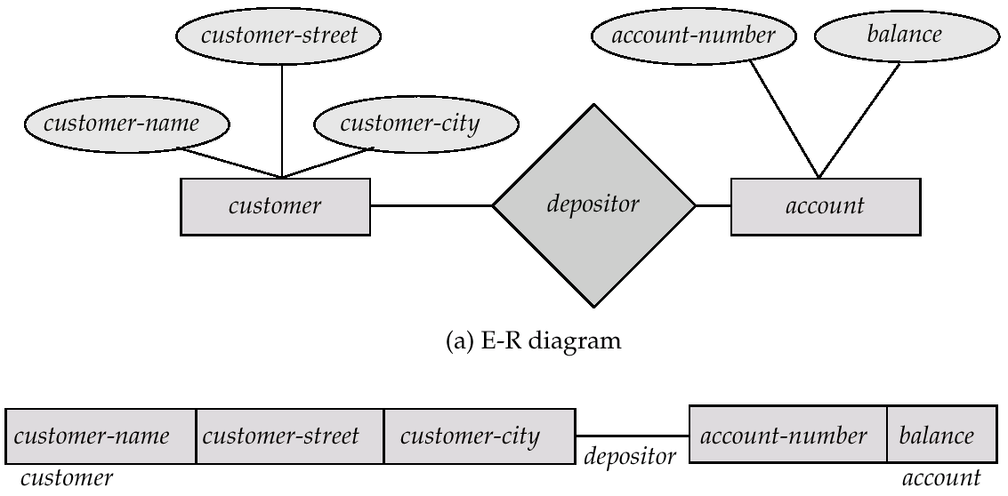
High-level or conceptual data model
Entity-Relationship (E-R) Model:

Slide 19
Representation or implementation of data model
Representation data model uses concepts that are understood by the end-user and are also close to the way the data is organized in the computer. These model hide the details of data storage.
The Data model are broadly classified as traditional data models that include
Hierarchial Data models
Relational Data Models
Network Data Models

Slide 20
Representation or implementation of data model
Hierarchical Data Model
Developed by IBM and is the oldest database model.
It organizes data in a tree-like structure, with a single parent node at the top (the root) and child nodes branching out below it. Each child node can have only one parent, but a parent node can have many children. So, it represents one-to-one and one-to-many relationship.
Key characteristics:
Tree-like structure: Data is organized with a single root node and child nodes branching out.
The schema is based on parent-child relationship: A parent can have none, one, or more children. A child can have only one parent.
Limited flexibility: Adding new data types or relationships can be complex due to the rigid structure.
Some of the hierarchical database implementations are the IMS system from IBM and System

Slide 21
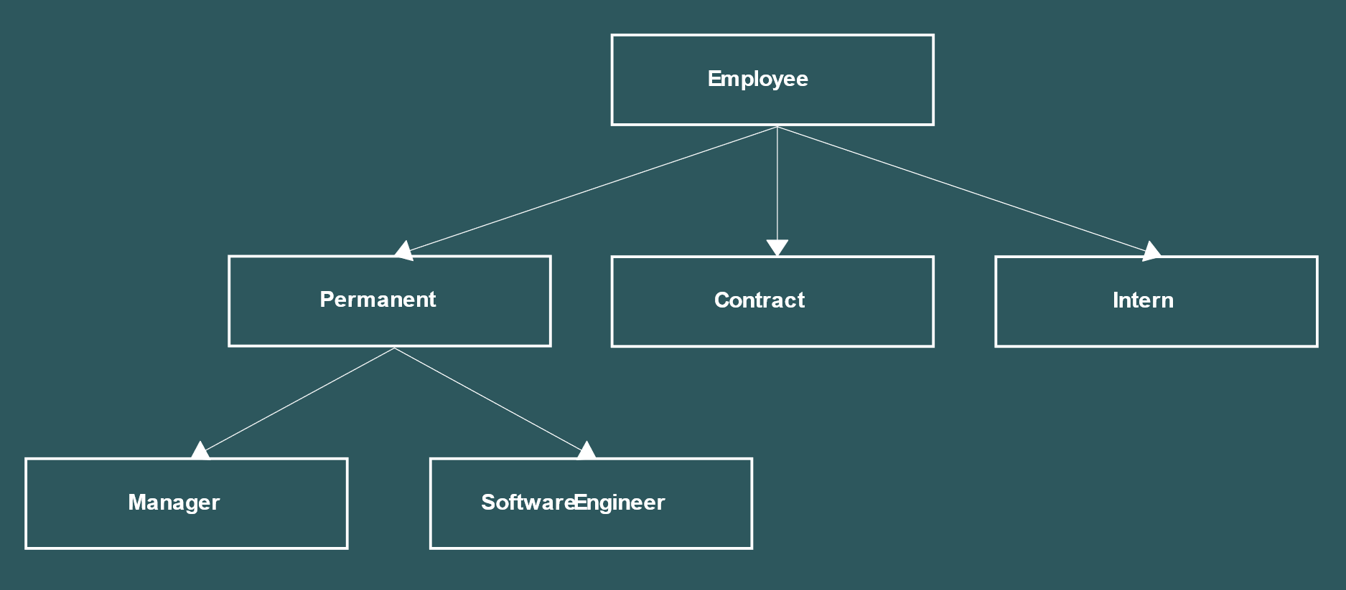
Representation or implementation of data model
Hierarchical Data Model

Slide 22
Representation or implementation of data model
Network Data Model
This model was formalized by the Database Task group (DBTG) in the 1960s. This model is the generalization of the hierarchical model.
It uses a directed graph structure, allowing a child node to have multiple parent nodes. This provides more flexibility in representing complex relationships between data entities.
The relationship among data elements can have many to many relationship.
Network models are less common today but can be useful for complex data with many-to-many relationships.

Slide 23
Representation or implementation of data model
Network Data Model
Key Characteristics
Tree structure with multi-parent nodes: A child record can have more than one parent record.
Sets: Define relationships between records across different record types.
More flexible than hierarchical model: Can handle complex data structures with many-to-many relationships.
More complex design: Can be trickier to design and manage compared to relational models.

Slide 24
Representation or implementation of data model
Relational Database Model
Relational data models are the most widely used today.
Proposed in 1970 by E.F. Codd.
They store data in two-dimensional tables with rows and columns. Each table represents a specific entity (e.g., customers, orders), and each row (tuple) represents a single instance of that entity. Columns define the attributes or properties of that entity (e.g., customer name, order date).
Relationships between tables are established through foreign keys, which reference primary keys in other tables.
Seceral commercial products like DB2, ORACLE, SQL Server, SYBASE, and INFORMIX are relational Database.

Slide 25
Representation or implementation of data model
Relational Database Model
Key Characteristics
Tables: Data is stored in tables with rows and columns.
Flexibility: New data types and relationships can be easily added by creating new tables or modifying existing ones.
Complex queries: Powerful query languages (like SQL) allow for retrieving data based on complex relationships between tables.
Data normalization: Techniques exist to minimize data redundancy and improve data integrity.

Slide 26
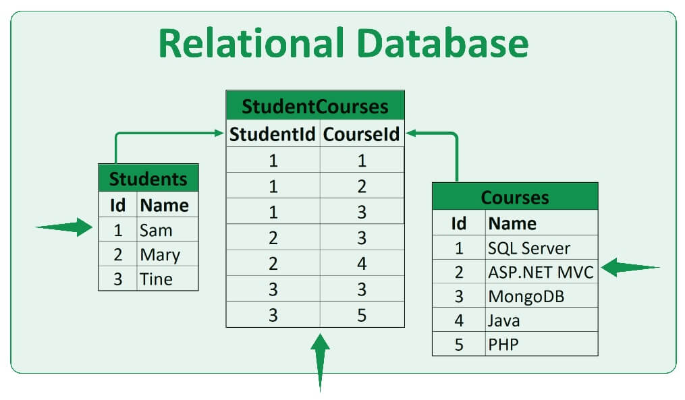
Representation or implementation of data model
Relational Database Model

Slide 27
Database System
A database system integrates the collection, storage, and dissemination of data required for the different operations of an organization, under a single administration.
A database system is a computerized record keeping system.
The purpose of the database system is to maintain the data and to make the information available on demand.
A database system has four main components:
Users
Hardware
Software, and
Data

Slide 28
Database System
Users:
The database system caters to various users with different needs and functionalities. These users can be broadly categorized into:
Database Administrators (DBAs): These are the technical experts who oversee the entire database system. They handle tasks like schema creation, user management, security, performance optimization, and backup/recovery.
Application Developers: They design and develop applications that interact with the database to store, retrieve, and manipulate data.
End Users: These are the individuals who utilize the applications built on the database system. They could be data analysts, customer service representatives, or anyone who needs to access or interact with the information stored within.

Slide 29
Database System
Hardware
The physical components that make up the database system. It includes:
Storage Devices: Hard disk drives (HDDs), solid-state drives (SSDs), and storage area networks (SANs) are used to store the actual database files and related information.
Processors (CPUs): These perform the calculations required for data manipulation, querying, and other database operations.
Main Memory (RAM): Provides temporary storage for frequently accessed data and program instructions, speeding up data retrieval.
Network Devices: Routers, switches, and cables enable communication between different components of the database system and facilitate user access.

Slide 30
Database System
Software
The software component encompasses various programs that work together to manage the database. The two main types are:
Database Management System (DBMS): This is the core software that interacts with all the other components. It provides functionalities for data definition (schema creation), data manipulation (insertion, deletion, updation), data retrieval (querying), data security, concurrency control (ensuring data integrity when multiple users access it simultaneously), and data recovery. Popular DBMS examples include MySQL, Oracle Database, Microsoft SQL Server, and PostgreSQL.
Application Programs: These are the software applications designed to interact with the database system through the DBMS. They allow users to create, access, and manipulate data specific to their needs.

Slide 31
Database System
Data
This is the heart of the database system – the actual information being stored and managed.
Data is raw numbers, characters, or facts represented by values. It can be numeric, non-numeric, images or pictures.
Data can be structured (organized in a predefined format like tables in a relational database) or unstructured (data with no specific format, like text documents or emails). The database system ensures data is organized, retrievable, and protected from unauthorized access or modification.

Slide 32
Architecture of Database System
The architecture of a database system provides a general framework for database systems. It refers to the overall structure and organization of its components, dictating how data is stored, accessed, and managed.
The American National Standards Institute (ANSI) and the Standards Planning and Requirements Committee (SPARC) proposed a standardized architecture for database systems. This architecture builds upon the three-level architecture but adds more details and functionalities:
External Level (View Level)
Conceptual Level (Schema Level)
Internal Level (Storage Level | Physical Level)

Slide 33
Architecture of Database System
External Level (View Level)
This level represents the user's view of the data. Users interact with the database through external schemas, which are essentially customized views of the data tailored to specific user needs or applications.
It uses the data model at the conceptual level
Conceptual Level (Schema Level)
It has a conceptual schema.
This level defines the overall structure of the database, independent of how the data is physically stored. It describes the entities (data objects) and their relationships and constraints.
Conceptual schema also uses the conceptual data model.

Slide 34
Architecture of Database System
Internal Level (Storage Level | Physical Level)
This level deals with the physical storage of data. It defines how the data is actually organized and accessed on storage devices physically. The internal schema describes how data is formatted, indexed, and stored, which is typically transparent to users and applications.
The physical data model is used to describe the physical schema.

Slide 35
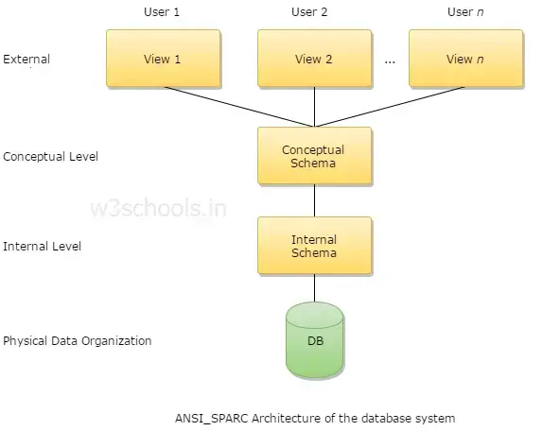
Architecture of Database System

Slide 36
Database Management System
Database Management System (DBMS) is a software tool to organize (create, retrieve, update, and manage) data in a database.
It acts as an intermediary between users and the database, providing functionalities to create, manage, and interact with data in a structured and efficient manner.
In a DBMS, the user interacts with the DBMS through the external view, and the data in the DBMS is stored at the physical level.
Any request from the user, would require that the DBMS access the data and then present it to the user as specified in the external schema.
Common commercial DBMSs are Oracle Database, IBMs DB2, Microsoft Access, MySQL.

Slide 37
Database Management System
Objectives of DBMS:
The primary objectives of a DBMS are:
It provides storage area for huge amount of related data.
Data Security and Integrity
Data Sharing and Concurrency Control
Data Backup and Recovery
Data Optimization and Performance

Slide 38
Database Management System
Functions of DBMS:
Data Catalog Management:
Acts like a library catalog for your database, keeping track of tables, columns, data types, and relationships between them. Makes it easier for users and applications to understand and find the data they need.
Transaction Management:
Groups multiple database operations (inserts, updates, deletes) into a single unit.
Ensures all operations within a transaction are completed successfully or completely rolled back if any part fails.
Maintains data consistency.

Slide 39
Database Management System
Functions of DBMS:
Concurrency Control:
Manages access to shared data by multiple users to prevent conflicts.
Uses locking mechanisms to temporarily restrict access to specific data elements while one user is modifying them. Ensures data integrity in a multi-user environment.
Security Management:
Enforces user access controls, defining who can view, modify, or delete data.
Protects sensitive information from unauthorized access.
Maintains data confidentiality and privacy.

Slide 40
Database Management System
Functions of DBMS:
Recovery Management:
Provides functionalities for restoring the database to a previous state in case of hardware failures, software errors, or accidental data deletion.
Offers backup and recovery tools to ensure data availability.
Language Interface:
Provides various languages for users and applications to interact with the database. The data structure are created using the data definition language and manipulation is done using DML.

Slide 41
Database Management System
Data Independence
Data independence is defined as the ability to change a schema at one level without affecting the schema at another level.
The DBMS acts as a translator between these schema levels, ensuring that changes at one level (e.g., internal schema) don't propagate to the others (external schema). This isolation allows for modifications to be made at the lower levels without affecting how users interact with the data.
There are two primary types of data independence:
Logical Data Independence
Physical Data Independence:

Slide 42
Database Management System
Logical Data Independence
Focuses on separating the logical structure (how users perceive the data) from the physical storage (how the data is actually stored on disk).
Imagine a library catalog. The catalog (logical view) tells you about the books (data) by title, author, etc., without revealing how the books are physically arranged on shelves (physical storage).

Slide 43
Database Management System
Physical Data Independence
Deals with insulating the logical structure from changes in the physical storage details (storage devices, file organization, access methods).
Analogy: Moving library books from one shelf to another (physical change) shouldn't affect how you find them in the catalog (logical view).

Slide 44
Database Management System
Data Dictionary:
Data dictionary stores the data about the actual data stored in the database.
Think of a library card catalog for your database. A data dictionary stores metadata, which is essentially data about your actual data. This metadata describes various aspects of your database, including:
Data Definitions: Definitions of all data elements (fields), including groups, records, tables, etc.
Data Structures: How data is organized within tables and related tables.
Data Rules and Constraints: Restrictions on data values (e.g., data type, length, minimum/maximum values) to ensure data integrity.
Data Item Descriptions: Brief explanations of what each data element represents.

Slide 45
Database Management System
Database Administrator (DBA)
DBA is a person or a group of persons who manages the data, determine the content, internal structure of DB and access strategy for a database, defines security and integrity and monitors performance. DBA has centralized control of the database and coordinates all activities of database system.
Functions of DBA:
Creating and maintaining database standards and policies
Supporting database design, creation, and testing activities
Managing the database availability and performance, including incident and problem management
Defining and implementing event triggers that will alert on potential database performance or integrity issues
Performing database housekeeping, such as tuning, indexing, etc.
Identifying reporting, and managing database security issues, audit trails, and forensics
Designing database backup, archiving, and storage strategy

Slide 46
Database Management System
Database Langauge
A database language is a special kind of programming language designed to interact with databases.DDL is used by database designers for defining the database schema. DML is used for the manipulation of data. Structured Query Language (SQL) is a relational database language that represents a combination of both DDL and DML. There are actually several different types of database languages, each suited for a specific task:
Data Definition Langage
Data Manipulation Language

Slide 47
Database Management System
Data Definition Language (DDL):
As the name implies, DDL is used to define the structure of a database. This includes things like creating tables, specifying the data types of each column in a table, and defining relationships between tables. Think of DDL as the blueprint for your database.
Since these commands can permanently alter the database structure, they are typically used by database administrators or for setting up the database initially. Some common DDL operations include CREATE, ALTER, DROP, and RENAME.
Eg: CREATE TABLE Employee
(ID int,
Name varchar(255),
Address varchar(255),
City varchar(100)
);

Slide 48
Database Management System
Data Manipulation Language (DML):
Once your database is defined, you need a way to manage the data itself. This is where DML comes in. DML statements are used to insert, update, and delete data from the database.
With DML, you can insert new data, update existing data, delete data, and query the database to find specific information. Common DML operations include INSERT, UPDATE, DELETE, and SELECT.
SELECT * FROM employee;
SELECT * FROM employee where id = 2;

Slide 49
Database Management System
There are actually two more common types of database languages:
Data Control Language (DCL): DCL statements are used to manage access to the database. This includes granting and revoking permissions for different users to perform DDL and DML operations on the database.
Transaction Control Language (TCL): TCL statements are used to manage transactions within the database. A transaction is a series of database operations that are treated as a single unit. TCL allows you to commit a transaction (making the changes permanent) or rollback a transaction (undoing the changes).

Slide 50
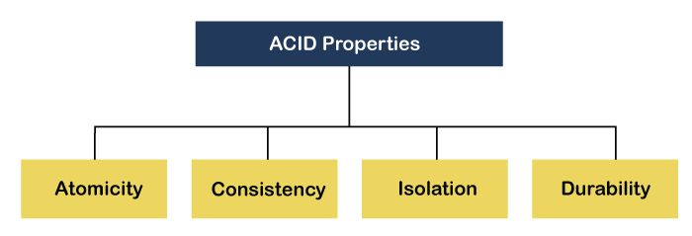
ACID Properties of Database
ACID properties are the foundation of ensuring reliable data transactions in databases. The expansion of the term ACID defines for: Atomicity, Consistency, Isolation and Durability

Slide 51
ACID Properties of Database
1. Atomicity
Imagine a bank transaction with two parts: debiting your account and crediting the recipient's account. Atomicity ensures this entire operation is treated as a single unit.
Either all parts of the transaction succeed, or if any part fails, the entire transaction is rolled back, leaving the database in its original state.
This prevents partial updates that could leave your data inconsistent. For example, in the bank scenario, if the debit from your account fails, the credit to the recipient's account shouldn't happen either.

Slide 52
ACID Properties of Database
2. Consistency
The word consistency means that the value should remain preserved always. In DBMS, the integrity of the data should be maintained, which means if a change in the database is made, it should remain preserved always. In the case of transactions, the integrity of the data is very essential so that the database remains consistent before and after the transaction. The data should always be correct.
3. Isolation
This property guarantees that concurrent transactions are isolated from each other and don't interfere with one another's data. Even if multiple transactions happen simultaneously, the results should be the same as if they were executed sequentially.

Slide 53
ACID Properties of Database
Durability:
This property guarantees that once a transaction is committed (marked as successful), the changes are persisted permanently in the database. Even if a system failure occurs, the changes won't be lost.
Once a transaction commits, the update is written to permanent storage, typically the hard disk. This ensures data integrity is maintained even in case of crashes or power outages.

Slide 54
Database system architectures
Centralized DBMS Architecture
In a centralized architecture, all the information resides on a single server. Clients, typically terminals with limited processing power in the past, connect to this server to access and manipulate the data. This approach offers:
Simplicity: There's one server to manage, and everyone uses the same data source.
Ease of Setup and Administration: Getting things up and running is relatively straightforward.
Limitations:
Scalability Bottleneck: As the number of users or data volume grows, the single server can become overloaded, hindering performance.
Single Point of Failure: If the server crashes, everything grinds to a halt.
Notes:
Clients communicate directly with the central database server, usually through a local network.
Example: A university might have a centralized database to store student records, course information, and grades. All departments, faculty, and students access this data from a central server via the network.

Slide 55
Database system architectures
Client-Server DBMS Architecture
This architecture distributes the workload. Here, the data remains on a central server, but clients, typically PCs or workstations with more processing power, handle tasks like user interface rendering and some application logic. They connect to the server to access and manipulate data.
Pros:
Scalability: Additional client machines can be easily added to handle increased user load. The server itself can also be upgraded for improved performance.
Improved Performance: By offloading tasks from the server, client-server architecture can deliver faster response times.
Cons:
Complexity: Managing multiple clients and the central server introduces some additional complexity compared to a centralized system.
Single Point of Failure: The central server remains a critical component. If it fails, the system becomes unavailable.
Notes:
Communication occurs over a network (e.g., LAN, WAN, or the internet).
In an e-commerce platform, the client-side (like a website or mobile app) interacts with the server-side DBMS (hosted on a database server) to retrieve product details, process customer orders, and update stock levels.

Slide 56
Database system architectures
Distributed Databases
In a distributed database, the data is scattered across multiple geographically dispersed servers or nodes. These nodes communicate and coordinate with each other to provide a unified view of the data to clients. This architecture is ideal for:
Large-scale data management: Distributing data across multiple servers allows for handling massive datasets.
Improved Availability: If one server fails, others can pick up the slack, minimizing downtime.
Limitations:
Complexity: Distributed databases are the most complex to design, implement, and maintain due to data synchronization and query processing across multiple locations.

Slide 57
Database system architectures
Distributed Databases
Site 1
Site 2
Site 5
Communication
Network
Site 4
Site 3

Slide 58
Database applications
Database applications are software applications built on top of a DBMS to manage and present information to users. They are the user-facing interfaces that leverage the power of databases. Here are some examples:
E-commerce applications: Store product information, customer details, orders, and transaction history.
Social media platforms: Manage user profiles, posts, comments, and relationships.
Banking systems: Store customer accounts, transactions, and financial data.
Library management systems: Track book information, borrowing history, and member details.
Inventory management systems: Keep track of stock levels, product details, and order fulfillment.
Human resource management systems: Store employee information, payroll data, and benefits details.

Slide 59
Data warehouse
Defined in many different ways, but not rigorously.
A decision support database that is maintained separately from the organization’s operational database
Support information processing by providing a solid platform of consolidated, historical data for analysis.
“A data warehouse is a subject-oriented, integrated, time-variant, and nonvolatile collection of data in support of management’s decision-making process.” - W. H. Inmon

Slide 60
Data Warehouse—Subject-Oriented
Organized around major subjects, such as customer, product, sales
Focusing on the modeling and analysis of data for decision makers, not on daily operations or transaction processing
Provide a simple and concise view around particular subject issues by excluding data that are not useful in the decision support process

Slide 61
Data Warehouse—Integrated
Constructed by integrating multiple, heterogeneous data sources
relational databases, flat files, on-line transaction records
Data cleaning and data integration techniques are applied.
Ensure consistency in naming conventions, encoding structures, attribute measures, etc. among different data sources
E.g., Hotel price: currency, tax, breakfast covered, etc.
When data is moved to the warehouse, it is converted.

Slide 62
Data Warehouse—Time Variant
The time horizon for the data warehouse is significantly longer than that of operational systems
Operational database: current value data
Data warehouse data: provide information from a historical perspective (e.g., past 5-10 years)
Every key structure in the data warehouse
Contains an element of time, explicitly or implicitly
But the key of operational data may or may not contain “time element”

Slide 63
Data Warehouse—Nonvolatile
A physically separate store of data transformed from the operational environment
Operational update of data does not occur in the data warehouse environment
Does not require transaction processing, recovery, and concurrency control mechanisms
Requires only two operations in data accessing:
initial loading of data and access of data

